Slide 1
BIOMEDIN 215 Data Science in Medicine
Nigam Shah, MBBS, PhD
nigam@stanford.edu
Notes:
To add:
nonparametric tests, bootstrap

Slide 2
The components of a learning algorithm
All models (functions)
Search space: what are the possible models to consider? (a set of functions)
Loss : given the data, how good do we consider each possible model? (a function of the model and the data)
Search strategy: how will we search the space of possible models to find the best one? (an algorithm)
search space
credit to Jerome Friedman (STATS 315B) for this framework

Slide 3
Goals for today
Review of predictions made using EHR data
Re-introduce ‘prediction-action’ pairing
Question the need for interpretability
Review one end to end example
Mortality prediction for advance care planning

Slide 4
Predictions using EHR data

Slide 5
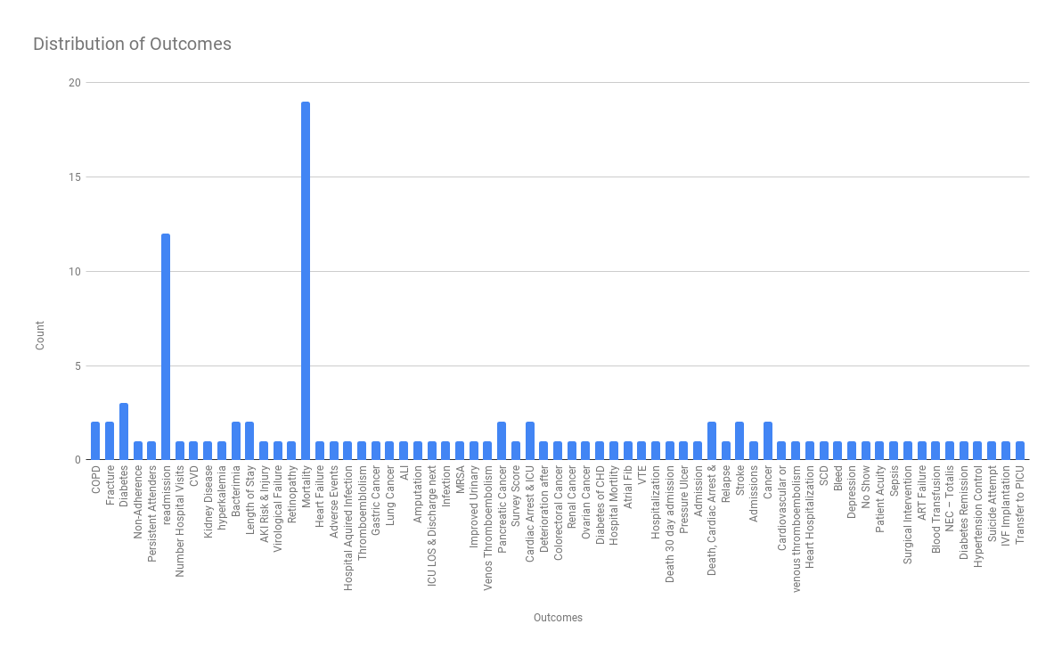
Predictive models using EHR data

Slide 6
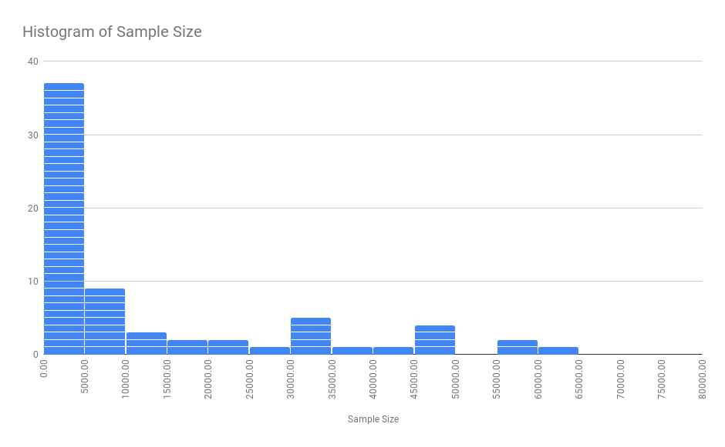
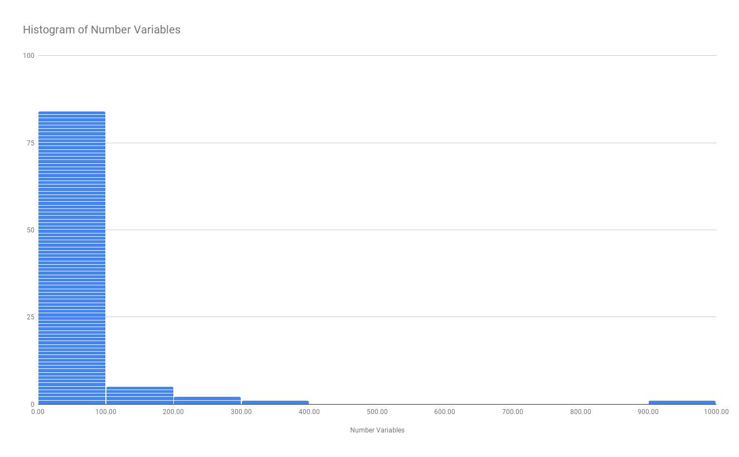
EHR data used across 107 models
Longitudinal data | Missing data | Loss to follow-up
Not considered (n = 71) | Not considered (n = 49) | Not considered (n = 40)
Peak value (n = 14) | Single imputation (n = 16) | In hospital event (n = 33)
Mean/Median (n = 7) | Multiple imputation (n = 21) | Time to event model (n = 22)
Count (n = 11) | Complete case (n = 10) | Linked to registry (n = 7)
Variability (n = 2) | Missing indicator (n = 12) | Remove those lost (n = 5)
Trend (n = 3) | Drop variable (n = 3)
Time Varying (n = 9)
Goldstein, B. A., Navar, A. M., Pencina, M. J., & Ioannidis, J. P. (2016). Opportunities and challenges in developing risk prediction models with electronic health records data: a systematic review. Journal of the American Medical Informatics Association, ocw042–11. http://doi.org/10.1093/jamia/ocw042
Notes:
Why use so few? Leverage the data! There are very few arguments for why you shouldn’t use information you have

Slide 7
Looking beyond predictions

Slide 8
A prediction is only as good as the action it triggers or prevents
Prediction
date
Time of event
0 min – N years
Patient’s Medical Record
Observed timeline
Window to take some action
Notes:
Cover difference between prediction and classification

Slide 9
Predictions are useless without actions
Prediction (label) | Action | Who
Undiagnosed FH | Order sequencing | Cardiologist or PCP
3–12-month Mortality | Goals of care planning | Anyone trained in SICP
Undetected Atrial fibrillation | Rhythm monitoring
Late wound healing | Vascular surgeon consult
Undetected depression | Evaluate using PHQ-9
Cost-Bloom in one year | Create custom care plan | Care coordination team
Need for drug dose reduction | Order PGx testing
Discharge in next 24h, 48h
Long length of stay
Readmission in next 30 days
Undiagnosed PAD | Measure ABI | Nurse practitioner
Notes:
The mind switch for us is to go from thinking about "pathways for groups of patients" based on retrospective data to thinking about the right action for Mr. John Smith given that he got flagged by three models at 8:00 am today.

Slide 10
Effective prediction-action pairing
Assume financial Risk
Take Action/s
Recommend Action/s
Provide a List
 | Undiagnosed FH | Mortality | Cost Bloom | Readmissions | …
Questions to ask about the action:
Should we take action?
What action to take?
Will the action work?
Question assumptions:
Reg, the existence of an alternative action
Reg, the need for interpretability
Reg, the incentives & capacity to act

Slide 11
Interpretability

Slide 12
Explaining mortality predictions
The patient record shows a case with metastatic breast cancer with malignant pleural effusions and empyema.
The patient’s record had 175,639 data points (tokens), which were considered by the model
Rajkomar, A., Oren, E., Chen, K. et al. Scalable and accurate deep learning with electronic health records. npj Digital Med 1, 18 (2018)

Slide 13
Given this prediction and interpretation:
Think for 2 minutes, what would you do?

Slide 14
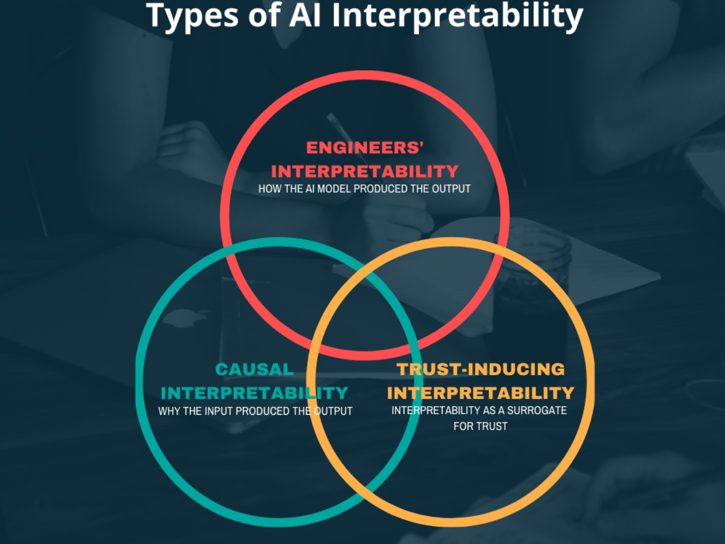
3 meanings of interpretability
https://tinyurl.com/donot-explain
Notes:
the ability to explain which variables and their combinations, in what manner, led to the output produced by the model. [HOW]
enough understanding of what is going on, so that they can trust the output. [TRUST]
enough causality in the model structure to provide ideas for what mitigating action to take. [WHY]

Slide 15
Perhaps: Black boxes might be better?
Manipulating and Measuring Model Interpretability. https://arxiv.org/abs/1802.07810
Notes:
Participants were shown models that varied in two factors thought to influence interpretability:
the number of input features
the model transparency (clear or black-box).
No significant difference in multiple measures of trust.
Increased transparency hampered people’s ability to detect when a model has made a sizeable mistake!
We need to empirically verify that interpretable models achieve their intended effects on end users.
In defense of the black box
Ghassemi et al, The false hope of current approaches to explainable artificial intelligence in health care - https://www.sciencedirect.com/science/article/pii/S2589750021002089

Slide 16
End to end example

Slide 17
Responsible AI in Healthcare https://tinyurl.com/useful-models
 | Task | Papers
1 | Needs Statement | -
2 | Use case definition | [6],[14],[19]
3 | Model formulation f: X → Y | [8],[9],[10]
4 | Model dev: Performance | [17]
5 | Model dev: Fairness | [12], [15],[18],[20]
6 | IT feasibility | [21]
7 | [Workflow / Org / App Integration] | [5],[21]
8 | Utility assessment | [1],[7],[13]
9 | Workload analysis | [3],[11], [22]
10 | Monitoring (workflow, model) | [16]
11 | Prospective evaluation | Coming!
12 | Ethical concerns review | [4], [23]
13 | Business case | [2]
Notes:
In healthcare, predictive models play a role not unlike that of blood tests, X-rays, or MRIs: They influence decisions about whether an intervention is appropriate. Whether a model is usefulness depends on the interplay between the model's output, the policy and capacity to take an action in response, and the action’s benefits and harms (the three-pronged star on the left).
We have created a team -- https://dsatshc.stanford.edu/ -- to assess whether a model-guided care situation is Fair, Useful, Reliable and as Monetary value. (i.e. FURM assessment – see https://scopeblog.stanford.edu/2022/10/03/researchers-create-guide-for-fair-and-equitable-ai-in-health-care/).
Thought leadership:
Liu et al, The number needed to benefit: estimating the value of predictive analytics in healthcare. https://doi.org/10.1093/jamia/ocz088
Morse et al, Estimate the hidden deployment cost of predictive models to improve patient care. https://doi.org/10.1038/s41591-019-0651-8
Shah et al, Making Machine Learning Models Clinically Useful. doi:10.1001/jama.2019.10306
Char et al, Implementing Machine Learning in Health Care - Addressing Ethical Challenges. DOI: 10.1056/NEJMp1714229
Seneviratne et al, Bridging the implementation gap of machine learning in healthcare. http://dx.doi.org/10.1136/bmjinnov-2019-000359
Li et al, Developing a Delivery Science for Artificial Intelligence in Healthcare. https://doi.org/10.1038/s41746-020-00318-y
Singh et al, Assessing the net benefit of machine learning models in the presence of resource constraints. https://pubmed.ncbi.nlm.nih.gov/36810659/
Research:
Jung Kenneth et al - Predicting need for advanced illness or palliative care in a primary care population using electronic health record data. https://doi.org/10.1016/j.jbi.2019.103115.
Avati, Anand et al - Improving palliative care with deep learning. https://doi.org/10.1186/s12911-018-0677-8
Avati, Anand et al - Countdown Regression: Sharp and Calibrated Survival Predictions, http://auai.org/uai2019/proceedings/papers/28.pdf
Jung Kenneth et al - A framework for making predictive models useful in practice, https://doi.org/10.1093/jamia/ocaa318
Pfohl, Stephen R et al. - An empirical characterization of fair machine learning for clinical risk prediction. doi:10.1016/j.jbi.2020.103621
Ko, Michael et al. - Improving hospital readmission prediction using individualized utility analysis.. doi:10.1016/j.jbi.2021.103826
Patel, Birju et al. - Learning decision thresholds for risk stratification models from aggregate clinician behavior. doi:10.1093/jamia/ocab159
Foryciarz, Agata. et al. - Evaluating algorithmic fairness in the presence of clinical guidelines: The case of ASCVD risk estimation. http://dx.doi.org/10.1136/bmjhci-2021-100460
Li, Ron et al - Using AI to Empower Collaborative Team Workflows: Two Implementations for Advance Care Planning and Care Escalation. https://doi.org/10.1056/CAT.21.0457
Lu, Jonathan et al - Assessment of Adherence to Reporting Guidelines by Commonly Used Clinical Prediction Models. doi:10.1001/jamanetworkopen.2022.27779
Lu, Jonathan et al - Considerations in the reliability and fairness audits of predictive models for advance care planning. https://doi.org/10.3389/fdgth.2022.943768
Seneviratne, Martin et al - User-centred design for machine learning in health care. http://dx.doi.org/10.1136/bmjhci-2022-100656
Yoo, Richard et al - Investigating Real-World Consequences of Biases in Commonly Used Clinical Calculators https://pubmed.ncbi.nlm.nih.gov/36716157/
Kashyap et al - A survey of extant organizational and computational setups for deploying predictive models in health systems doi: 10.1093/jamia/ocab154
Wornow et al - APLUS: A Python Library for Usefulness Simulations of Machine Learning Models in Healthcare https://pubmed.ncbi.nlm.nih.gov/36791900/
Cagliero et al - A framework to identify ethical concerns with ML-guided care workflows: a case study of mortality prediction to guide advance care planning https://doi.org/10.1093/jamia/ocad022
Blog posts at HAI -- https://hai.stanford.edu/healthcare
Does every model need to be explainable?
Do healthcare models need to be generalizable?
How do we make sure healthcare algorithms are fair?
How can we make sure healthcare models are useful?
Are medical AI tools delivering on what they promise?
What should healthcare executives know?
How can foundation models advance healthcare?
How are shaky are the foundation models in medicine?
Do language models support clinician information needs?

Slide 18

Developing a delivery science for AI solutions
Use case definition
Given a prediction, what action would someone take?
Model development
How do we get the best f: X → Y?
Is f: X → Y fair?
Utility assessment
Given the cost of action and its benefit, is there net benefit?
Monitoring reliability
Execution of workflow and monitoring the model.
Model formulation f: X → Y
Use an existing model or learn a new one.
IT/TDS feasibility
Can we get the data in time to make prediction by 6 am?
Workload analysis
Given ‘work capacity’, what net-benefit can we realize?
Prospective evaluation
Does the running system have the impact we hoped?
Figure 3, from “A framework for making predictive models useful in practice” Kenneth Jung et al. https://doi.org/10.1093/jamia/ocaa318
Notes:
This slide is a summary of the process we have arrived at after doing the ~15 projects under the Program for AI in healthcare.
In the first step we attempt to nail down that if a prediction were possible, what action would someone take, and is that action ethical? Simultaneously we also assess the need to learn a F:X → Y; given that there are over 250,000 publications about clinical risk scores already out, there is a high chance that a good enough model might already exist.
In the second step, we attempt to learn the best possible model -- i.e. a function mapping X → Y. We agonize over the data types to include, the model architecture, and ensuring that the model is as fair as possible. Simultaneously we assess practicalities of obtaining the necessary data on a new patient in a live hospital IT system to run the model and obtain a classification, prediction, or recommendation for a specific patient.
In step 3, we design the workflow that will be triggered based on the model’s output and assess its potential net-benefit as well as estimate what fraction of that can we realize given work capacity constraints. [very few places do this]
Finally, we have a deployment model, which needs to be monitored. Simultaneously we begin a prospective study to prove that having a model-triggered clinical workflow is indeed having the impact we hoped it would.

Slide 19
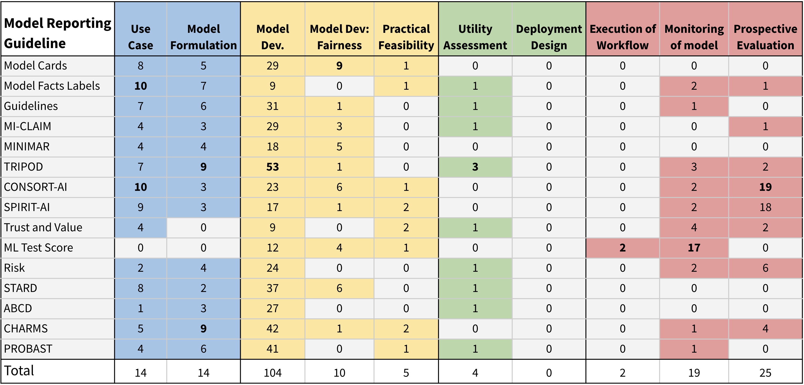
Many recommendations for Responsible AI
Jonathan Lu et al. “Assessment of Adherence to Reporting Guidelines by Commonly Used Clinical Prediction Models.”
doi:10.1001/jamanetworkopen.2022.27779
Notes:
Without clear communication about how a model is built and what it does, it’s extremely difficult to get a sense for what advantages, disadvantages, and consequences a model may have

Slide 20
Fig. 4, as a table
1 | Needs Statement That specifies the problem a model is expected to solve.
2 | Use case definition Given a prediction, what action would we take?
3 | Model formulation f: X → Y Use an existing model or a new one.
4 | Model dev: Performance How do we get the best f: X → Y?
5 | Model dev: Fairness Is f: X → Y fair?
6 | IT feasibility How do we get the data in time to make predictions?
7 | [Workflow / Org / App Integration] How do we get the model output back into care workflow?
8 | Utility assessment Given the cost of action, is there net benefit?
9 | Workload analysis Given ‘work capacity’, what net-benefit can we realize?
10 | Monitoring (workflow, model) Making predictions and monitoring the model as well as workflow.
11 | Prospective evaluation Does the system have the impact we hoped?
12 | Ethical concerns Surfaced by stakeholder interviews
13 | Business case Enterprise value given the model, the intervention, and patient mix
Oct 2015
Feb 2016
Feb 2017
Jan 2019
Mar 2020
Mar 2022
Notes:
Lance looped in Feb 14, 2017, 4:15 PM
Ron looped in Jan 22, 2019, 12:56 PM

Slide 21


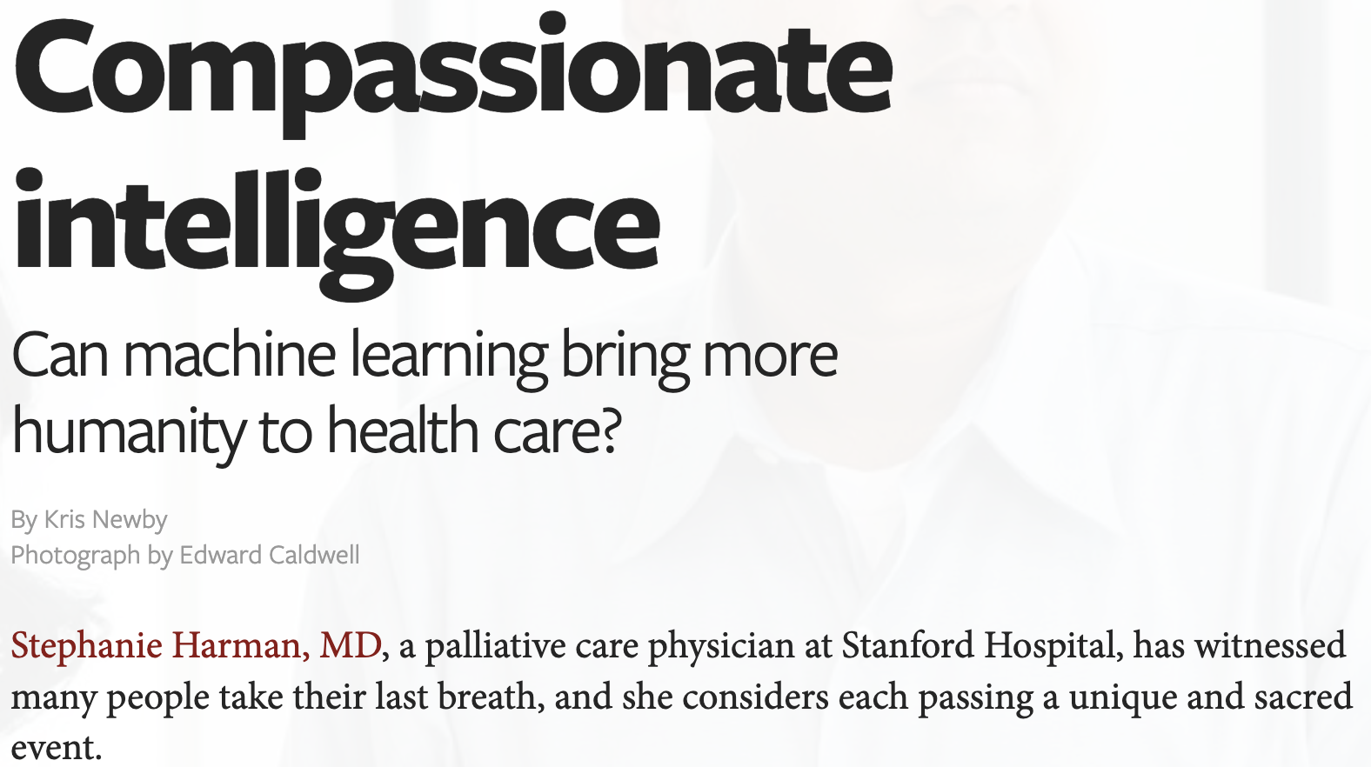
1: Needs statement
Original needs statement for the ACP project:
PROBLEM: patients fail to have their wishes carried out at their end of life and this translates in an overuse of aggressive care.
OUTCOME: increase the rate of advance care planning received by patients who need it the most.
A model can only help address a piece of the problem, leading to a refined version:
PROBLEM: physician referrals and manual chart reviews fail to target the patients who may benefit from palliative care with an objective criterion.
OUTCOME: increase the rate of advance care planning received by patients 6 months before they pass away.
Lisa Shieh
Stephanie Harman
https://stanmed.stanford.edu/2018summer/artificial-intelligence-puts-humanity-health-care.html
Notes:
https://stanmed.stanford.edu/2018summer/artificial-intelligence-puts-humanity-health-care.html
This ”needs finding” happened because Bob Harrington put me on the DOM’s quality committee, which Stephanie was also on.

Slide 22

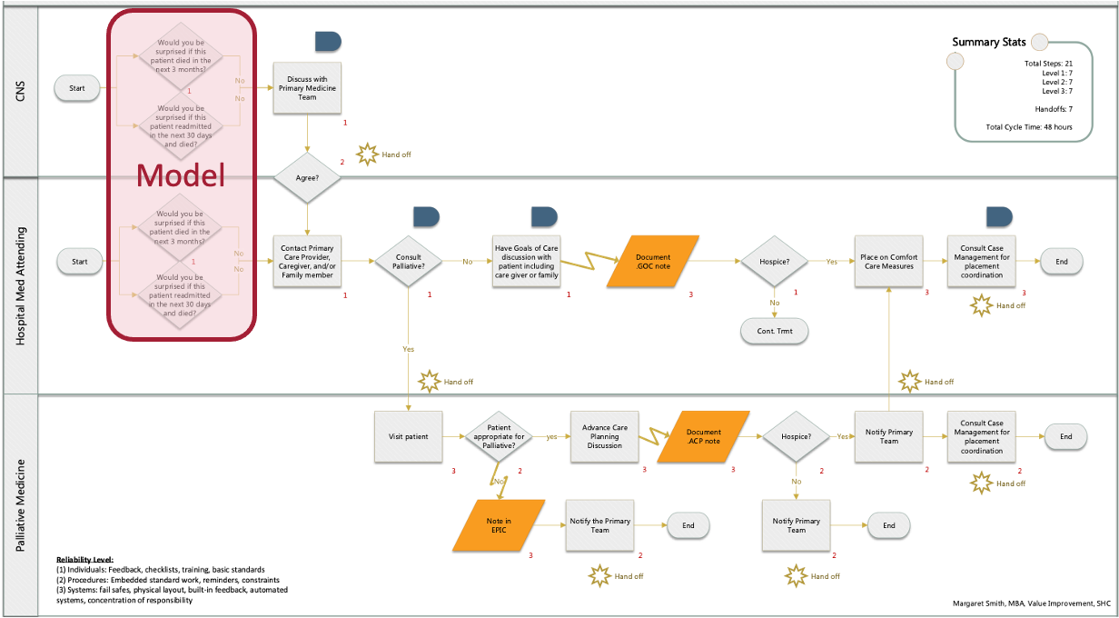
2: Use case definition
Ken Jung
Margaret Smith
Advance Care Planning: too little, too late
The workflow: 21 steps, 7 handoffs, 48 hrs
Notes:
On the left is a histogram of the fraction of individuals who have documented ACP before a certain number of days before death (x-axis). As you can see, most of the ACP conversations and documentations happens in the month prior to someone’s passing.
On the right, is the workflow for doing advanced care planning (ACP) at Stanford Healthcare; it has 21 steps, 7 hand offs, and takes 48 hours. Knowing this workflow is crucial because the “model” is only occupying the red box on this workflow. The net-benefit to patient care is dependent on a host of other factors, and often a 2% improvement in prediction accuracy does not lead to any improvement in care. That’s tough news but is worth knowing up front!

Slide 23
3: Model formulation
Model formulation: Predicting a surrogate event
EPIC End of life Index evaluation, should ideally have occurred here!
Ken Jung
Anand Avati
Notes:
Ideally, we’d have labeled records telling us which patients are likely to benefit from advance care planning and who will not. However, we do not have that kind of labeled records. So we use a surrogate outcome/event of mortality, assuming that anyone who is likely to die will benefit from advance care planning. It is an assumption whose appropriateness we then have to verify.
We did not have the option of using Epic’s cognitive compute and the EOL index model at that time.

Slide 24
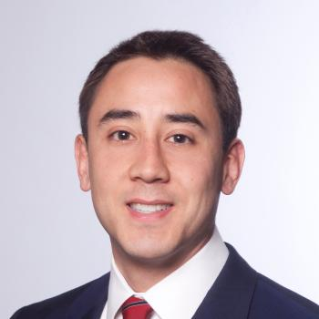
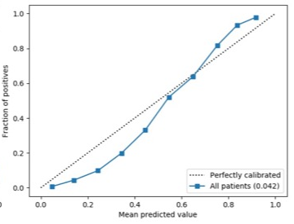
4: Model dev: Performance
Lance Downing
Ken Jung
Anand Avati
Multiple models for 3-12 month mortality
Examined effect of data density, index-time, outcome-time.
Evaluation using held out test-sets
AUC = 0.85 | AUPRC = 0.41
AUC = 0.81 | AUPRC = 0.39
Notes:
Jung Kenneth et al - Predicting need for advanced illness or palliative care in a primary care population using electronic health record data. J Biomed Inform. 2019;92:103115.
Avati, Anand et al - Improving palliative care with deep learning. BMC Med Inform Decis Mak. 2018 Dec 12;18(Suppl 4):122. PMID: 30537977.
Avati, Anand et al - Countdown Regression: Sharp and Calibrated Survival Predictions, http://auai.org/uai2019/proceedings/papers/28.pdf
Lot’s of fun computer science happened. TL;DR = we got a good performing model

Slide 25


5: Model dev: Fairness audit
Rebecca Fong Briththa Seevaratnam, Michael Francis Gensheimer, Ali Raza Khaki, Kavitha Ramchandran,
Melanie J. Hanson,
Samantha Wang, Lisa Shieh
Winnie Teuteberg
Jonathan Lu
Usual focus of algorithmic fairness
True probability
No. of “outcomes” achieved
Predicted probability
Percentage of the population intervened
Reliability and fairness audits of predictive models for ACP Jonathan Lu et al. https://doi.org/10.3389/fdgth.2022.943768
Evaluating fairness in the presence of clinical guidelines
Agata Foryciarz et al. http://dx.doi.org/10.1136/bmjhci-2021-100460
Notes:
Rebecca Fong Briththa Seevaratnam, Michael Francis Gensheimer, Ali Raza Khaki, Kavitha Ramchandran,
Melanie J. Hanson,
Samantha Wang, Lisa Shieh

Slide 26



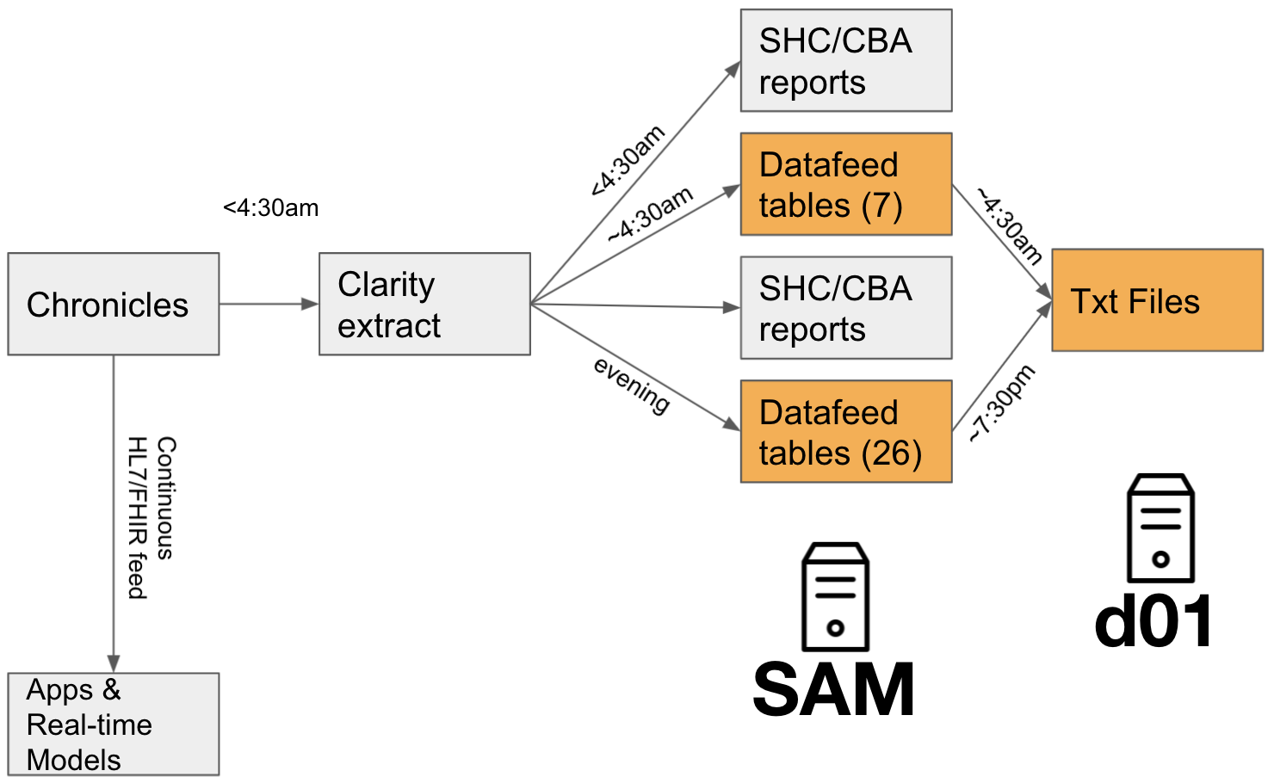
6: IT feasibility
Ken Jung
Sigi Javitz
Yohan Vetteth
Kenny Shum
Manual reconciliation of the “variables” across the research CDW (STRIDE) and the live data.
The “33 tables” data feed available on a SOM server (shahlab-secure).
Integration into work application via emails / APIs (next slide).
Notes:
No papers – just a slide deck at https://docs.google.com/presentation/d/1SYyHHd4rk1pciL1e1fGbH3j2kQojuYruNku05uhZL9I/edit#slide=id.p (accessible to anyone with a sunet id). The point here is that procuring the live data of the patient on whom a prediction needs to be made at 8:00 am is a nontrivial challenge given the state of IT in health systems. The cost and agony of procuring such data feeds is high and leads to odd economics.

Slide 27




5 questions to build and deploy a model
Research - “Model development”
Operations - “Model deployment”
Q1: How to obtain the data to train models
Q3: How to obtain the current and historical data to apply a model (do inference)
Production system e.g. EPIC Caché
e.g. STARR
f:X → Y
EDW, e.g. Health Catalyst
Q5: Clinical Integration, follow up action, and evaluation of the model-enabled workflow
Q2: Where do we run inference for a new patient’s data?
Q4: How to send the model’s output (i.e. probability estimate) back into clinical workflow?
Notes:
Q3: For real time data, there are three options HL7, reporting workbench, and Epic APIs (internal, FHIR)

Slide 28

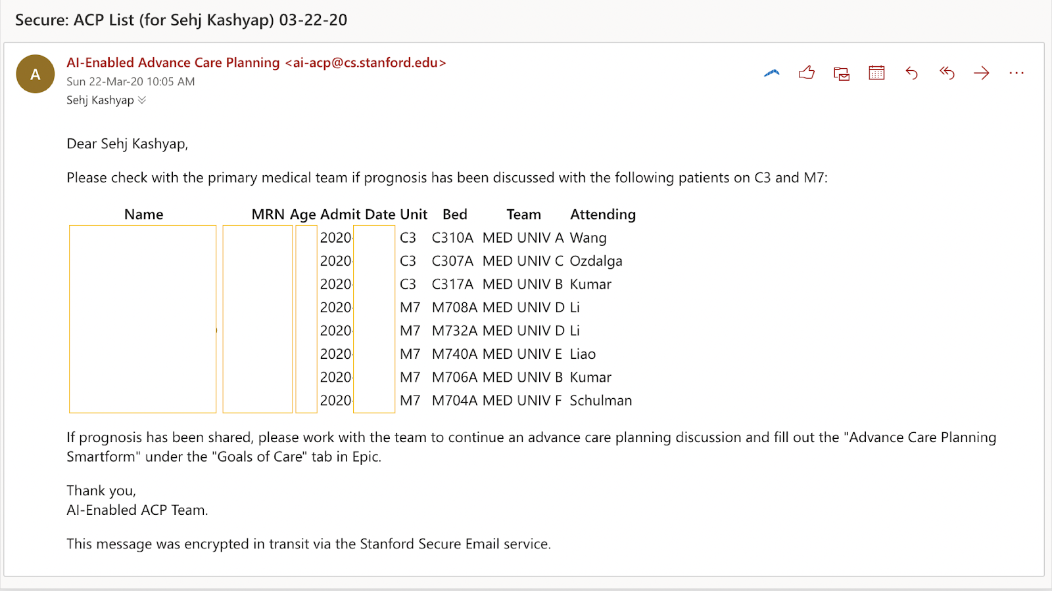
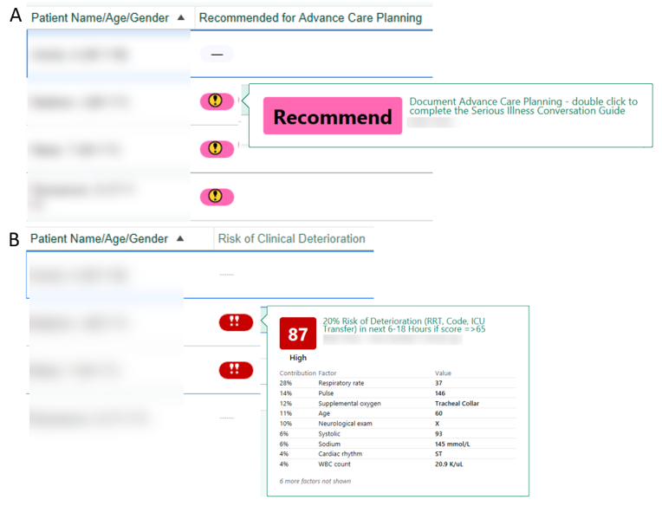
7: Clinical Integration
Ron Li
Robert Maclay
Jonathan Lu
Sehj Kashyap
Notes:
Blog post is at https://tinyurl.com/team-acp and paper is coming out in NEJM Catalyst on March 16th.

Slide 29
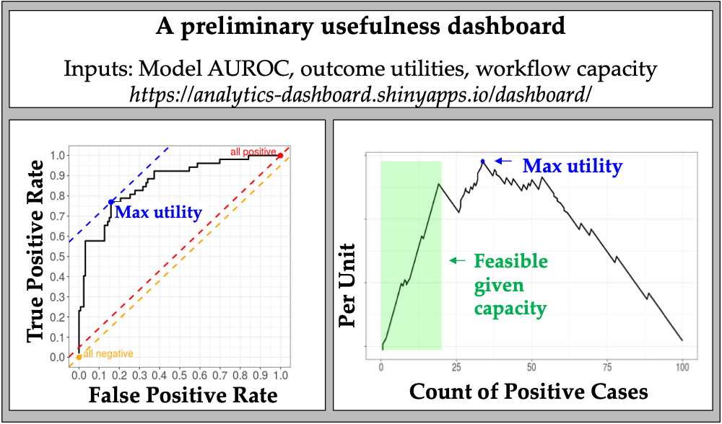
8: Utility assessment
Ken Jung
Steven Bagley
Is there utility, given cost and benefit of actions?
What is the achievable utility, given work capacity?
https://analytics-dashboard.shinyapps.io/dashboard/
Notes:
Utility analysis implemented at https://analytics-dashboard.shinyapps.io/dashboard/
Values obtained from RCT.
FN = 37,085 = Gade et al. original value of 21252 * inflation multiplier of 1.745
TP = 28,613 = Gade et al. Net savings of 4855 * inflation multiplier, subtracted from 37,085
FP = 14,970 = 11,646 + inflation adjusted cost of intervention (3,324)
TN = 11,646 = Per capita spend in US, 2018, Peterson-Kaiser
U (TP – FN) = 28,613 – 37,085 = -8,472
Spending $3,324 to save $8,472. The green zone in the lowermost image shows how far down the list do we get with the current work capacity.

Slide 30
9: Workload analysis
Ron Li
Sehj Kashyap
Heather Shaw
Stephanie Harman
Quantify the increased workload
Establish a baseline
Quantify the expected improvement
Quantify the effect of delivery factors via workflow simulation
“3 or more admissions” heuristic, flags 21% of cases; screen 2.46 cases to find one true case.
69% increase in triggering the workflow in internal medicine.
At 21% recall, cuts screening in half. At fixed work, finds 4x cases.
Simulation of 500 days of patient throughput, with the ACP workflow failing at different steps with certain probabilities.
Notes:
We built a model to predict: 3-12 month mortality; so first we verified the validity of the surrogate label -- 235 patients in a blinded prospective study to ensure that using mortality as a surrogate does find people who will benefit from advance care planning.
The model finds cases 58 days earlier than the heuristic.
This effort was done as a CELT project
Simulation of 500 days of patient throughput, with the workflow failing at different points with certain probabilities, is described in Jung Kenneth et al - A framework for making predictive models useful in practice, https://doi.org/10.1093/jamia/ocaa318.

Slide 31



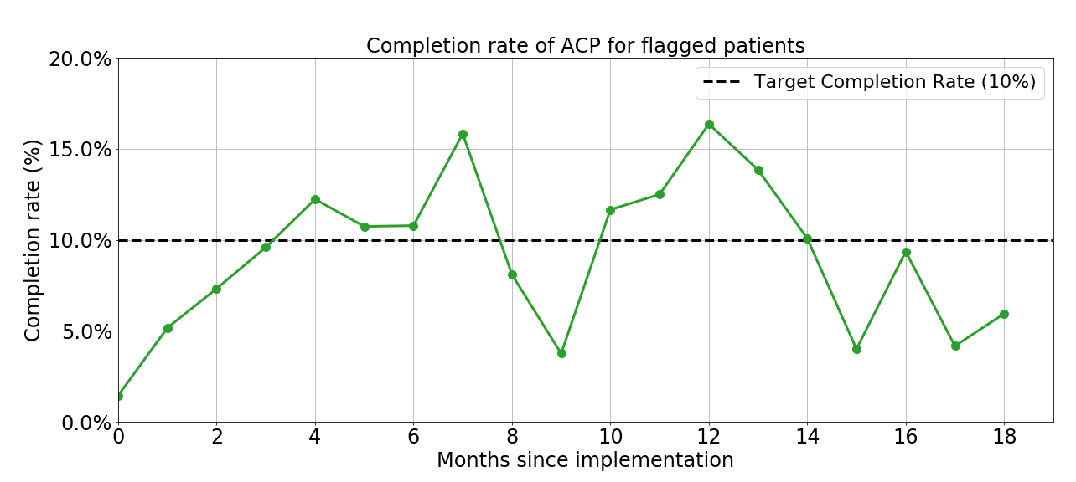
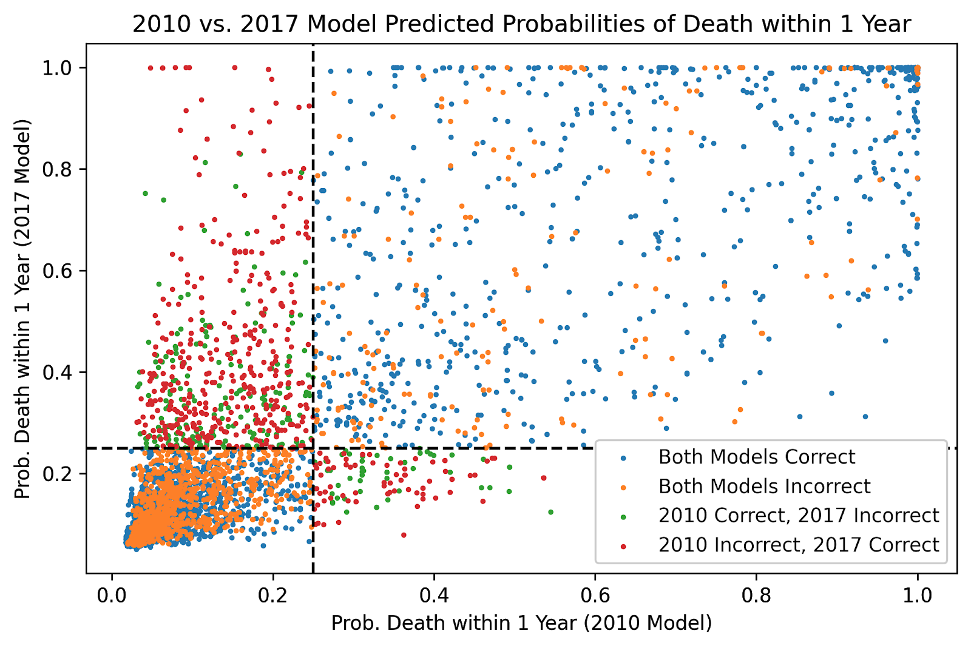
10: Monitoring
Scott Fleming
Ethan Steinberg
Siyun Li
Jonathan Lu
Ron Li
Workflow Monitoring
The price of data-drift

Slide 32
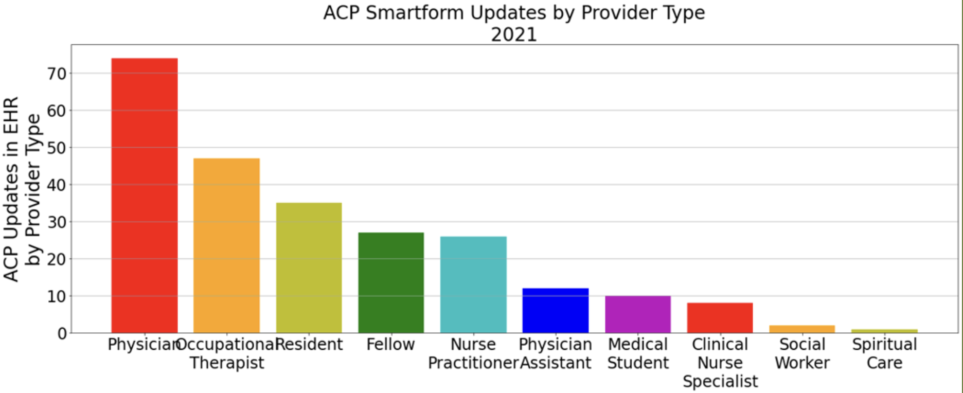
11: Prospective Eval.
Anand Avati
Margaret Smith
Jonathan Lu
Ron Li
Notes:
Blog post is at https://tinyurl.com/team-acp and paper is out in NEJM Catalyst https://catalyst.nejm.org/doi/full/10.1056/CAT.21.0457

Slide 33
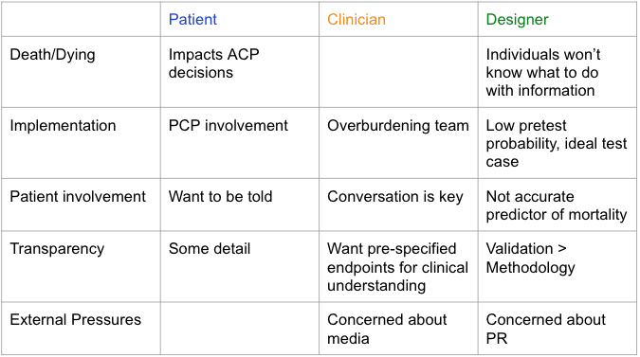
12: Ethical concerns
Danton Char
Evaluating ethical concerns with an application of machine learning to guide advanced care planning Diana Cagliero, Natalie Deuitch, Nigam Shah, Danton Char
Notes:
https://pubmed.ncbi.nlm.nih.gov/36826400/

Slide 34
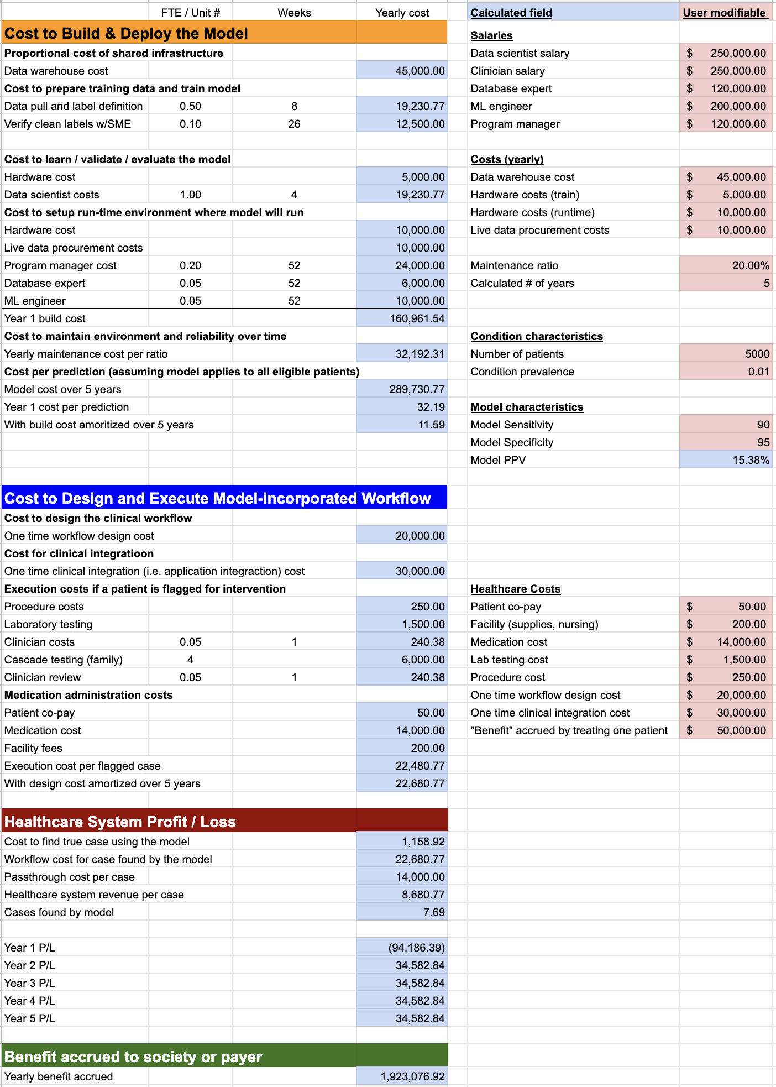

13: Business case
Dev Dash
Example shown is for screening for familial hypercholesterolemia using an EHR based classifier
Notes:
In the MCiM program, 5 teams assessed one use case each for the financial viability of using a model’s prediction to trigger a workflow

Slide 35
Current process (Feb 2023)
12. Ethical concerns
Surfaced by stakeholder interviews
13. Business case
Enterprise value given the model, the intervention, and patient mix
10. Monitoring
Making predictions and monitoring the model + workflow
3. Model formulation f: X → Y
Use an existing model or learn a new one.
1. “needs statement”
That specifies the problem a model is expected to solve
Intake
Summary Report
6. IT feasibility
Can we get the data in time to make prediction by 6 am?
11. Prospective evaluation
Does the running system have the impact we hoped?
2. Use case definition
Given a prediction, what action would someone take?
7. [Clinical / Org / App Integration]
How do we get the model output back into clinical workflow?
9. Workload analysis
Given ‘work capacity’, what net-benefit can we realize?
4,5. Model training and testing
How do we get the best f: X → Y?
Is f: X → Y fair?
8. Utility assessment
Given the cost of action and its benefit, is there net benefit?
Did it work?
How
What & Why

Slide 36
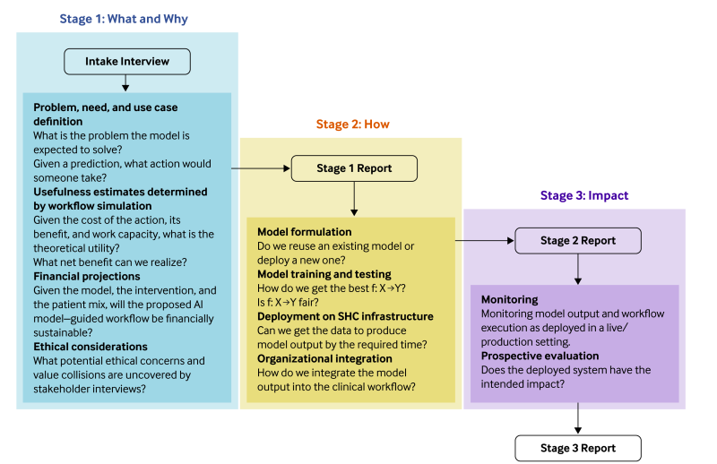
FURM as of 2024 – http://furm.stanford.edu

Slide 37
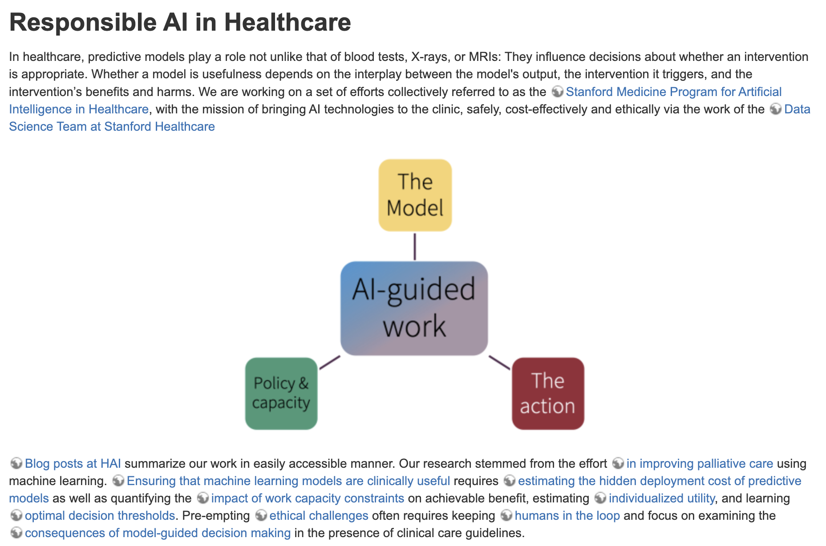
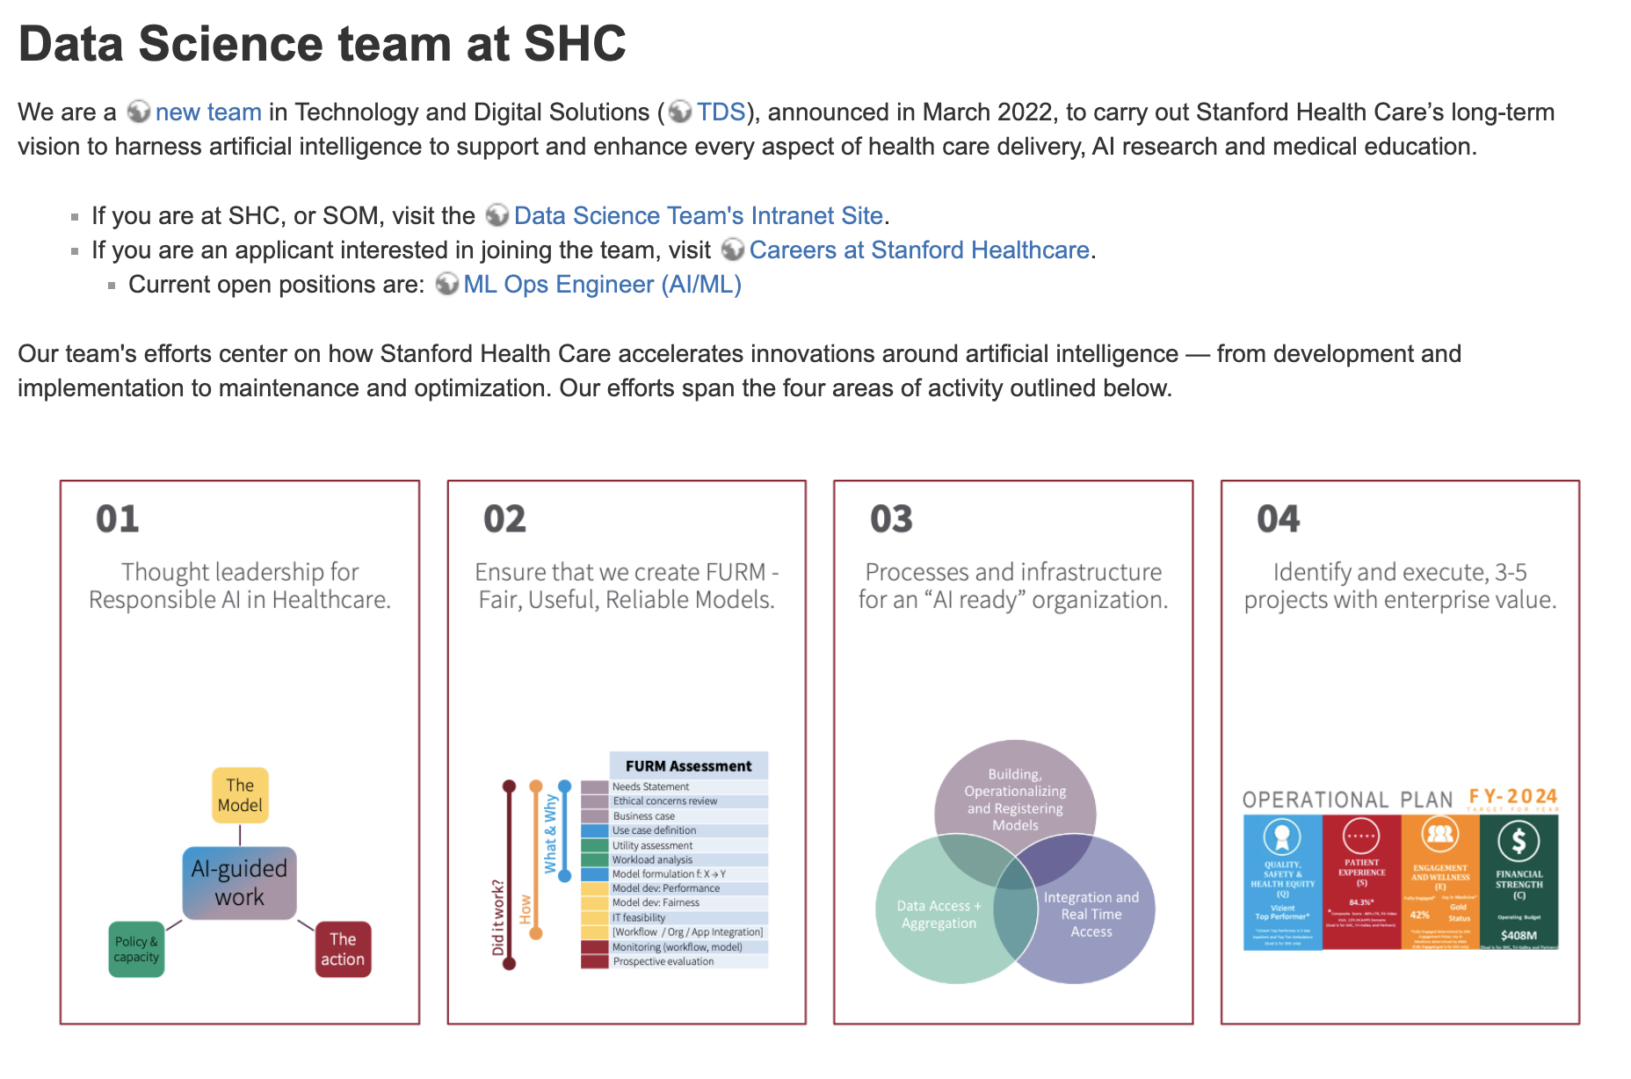
https://shahlab.stanford.edu/aihc-programs lists 19 programs on our campus
https://rail.stanford.edu/
https://dsatshc.stanford.edu/

Slide 38
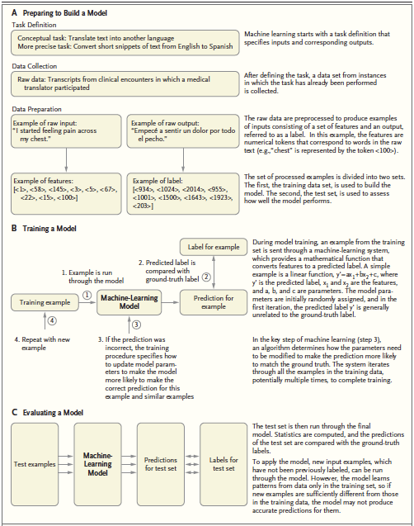
Assigned reading:
Rajkomar A, Dean J, Kohane I.
Machine Learning in Medicine.
N Engl J Med. 2019;380(14):1347-1358.
doi:10.1056/NEJMra1814259

Slide 39
Alt reading: www.tinyurl.com/hai-blogs
Does every model need to be explainable?
Do healthcare models need to be generalizable?
How do we ensure that healthcare algorithms are fair?
How can we ensure that healthcare models are useful?
Are medical AI tools delivering on what they promise?
What should healthcare executives know?
How can foundation models advance healthcare?
How are shaky are the foundation models in medicine?
Do language models support clinician information needs?

